Slide 1
Formal Correspondence

Slide 2
Business correspondence means the exchange of information in a written format for the process of business activities.
Business correspondence can take place between organizations, within organizations or between the customers and the organization.
The correspondence refers to the written communication between persons.

Slide 3
Documents used for Correspondence
LETTERS
MEMORANDUM
EMAIL

Slide 4
Formal letter and formats

Slide 5
3 types of format,
Full Block
Modified Block
Semi-Block

Slide 6
Full block
Block format features all elements of the letter aligned to the left margin of the page.
It has a neat and simple appearance.
Paragraphs are separated by a double line space.

Slide 7
Sender's address
Sender's phone number
Today's date (drop down 4 lines)
Recipient's name
Recipient's company name
Recipient's address (2 space)
Dear Name:(1 space)
In this type of block letter, all the paragraphs line up at the left margin. There is no indenting of the paragraphs. The margins should be set to 1-1.5" all the way around the page. If you are using company letterhead, you will need to account for that in figuring the margin where the letterhead is placed on the page. (1 line space)
Format sample

Slide 8
Contd.
You only need to single-space between sentences. Leave an extra open line between paragraphs. Keep in mind that these sample letters are a guideline. People often customize to meet their preferred style. (1 line space) Some people choose to center the above sender information.
(2 line space) Sincerely,
(space down four lines)
Signature here
add name,
add title
[Identification initials]

Slide 9
20-54 Jackson Avenue
Brooklyn, NY 11352
June 28, 2007
Ms. Jennifer Esposito
John Doe Fellowship
595 Park Avenue
New York, NY 10021
Dear Ms. Esposito:
The John Doe Fellowship has always loomed on the horizon for me. Ever since I decided to major in history, I have wanted to participate in your program. From the research that I have done, I believe that your program provides its participants with an extensively detailed look at the history of the world through hands-on experience with fossils, artifacts, and other remains that compose the blueprint of our existence. I am applying for the John Doe Fellowship because I believe that it would benefit me throughout my career and allow me to further understand the ideas behind history and how it is constructed. I am a very committed and goal-oriented person with excellent interpersonal skills. My background in history involves studying many different eras and time periods. My specialty, though, is the archeological study of the ancient world and its history. During the summer of 2004 and 2005, I interned at the Metropolitan Museum of Art as a tour guide. Both times, I not only utilized my knowledge of art and its history, but I also learned a lot about how that history was constructed.
This experience has influenced me to intern as a tour guide at the American Museum of Natural History, where my love for the origins of history and learning from the tactile experience with artifacts increased. In the future, I would like to participate in historical research and eventually become a full-time professor of history. I believe my skills, experience, and goals make me an excellent candidate for your program.

Slide 10
This experience has influenced me to intern as a tour guide at the American Museum of Natural History, where my love for the origins of history and learning from the tactile experience with artifacts increased. In the future, I would like to participate in historical research and eventually become a full-time professor of history. I believe my skills, experience, and goals make me an excellent candidate for your program.
This experience has influenced me to intern as a tour guide at the American Museum of Natural History, where my love for the origins of history and learning from the tactile experience with artifacts increased. In the future, I would like to participate in historical research and eventually become a full-time professor of history.
I believe my skills, experience, and goals make me an excellent candidate for your program.
Thank you very much for considering me for the John Doe Fellowship. I am
looking forward to hearing from you.
Sincerely,
Bill Lurie
(419) 352-5425
Enclosure

Slide 11
Modified block format
Modified block differs from block style in that the date, sign off, and signature lines begin at the center point of the page line.
The beginning of each paragraph is indented five spaces, along with the subject line, if used. Depending on the length of the letter, paragraphs may be separated by a single or double line space.

Slide 12
123 Corona Blvd.
Flushing, NY 1123
July 3, 2007
Dr. Steven Serafin,
Director Reading/Writing Center
Hunter College
695 Park Ave
New York, NY 10065
Dear Dr. Serafin:
My name is Sally Eisner. I am writing this appeal to request a 4th chance to take the CUNY Proficiency Exam in June of 2007. I have taken the exam twice and missed it once. The first time, I feel that I was simply unprepared. I did not realize that I should have attended CPE workshops offered at the Reading/Writing Center. The second time, I attended the workshops and learned more about the exam; however, my Task 2 score was unsatisfactory, so I failed again. Finally, I registered for CPE tutoring at the Reading/Writing Center and studied very hard for the third time. However, on the Saturday of the exam, I had a family emergency, which caused me to miss the date. I had forgotten that I could defer the test date until after I missed it.

Slide 13
Now, I am working hard to build on my academic skills. After a consultation with a CPE advisor at the Reading/Writing Center, I have a clear vision of what I should do in order to pass the exam. Again, I have registered for a semester of CPE tutoring at the Writing/Reading Center that I plan to attend weekly.
I would really like to have a 4th chance to pass this exam because I am confident that if I work hard, I can do it. Thank you very much for considering my appeal. I hope to hear back from you soon.
Sincerely,
Sally Eisner

Slide 14
Semi-Block format
It is similar to the modified block format, except that the first line of each paragraph is indented.
This format is more conventional for informal personal letters in which we want to exude a warm, relaxed and friendly correspondence style.

Slide 16
Three Types of Business Letters (content-wise)
Positive/neutral message letter
Negative message letter
Persuasive message letter

Slide 17
Business Letter Types Based on the Nature of the Message
Positive/Neutral message | Negative/Bad news or message | Persuasive message
Regular requests for action, information or recommendation Responding to requests Claims or adjustment (complaints) Goodwill messages (congratulatory messages, appreciation messages, condolences) | a refusal a rejection negative announcement | Cover letter Sales letter Recommendation letters Securing clients

Slide 18
Some examples of requests
placing an order
making business reservations and appointments
requesting action related to routine business procedures
making claims requests for adjustment (about damaged, faulty, wrong or late goods)
making complaints (about poor service, unfair billing, impolite letters)
inquiring about products and services
inquiring about persons (references by a person interested in an applicant.)

Slide 19
Organizing Positive Neutral Messages- The Direct Approach
Main Idea/Purpose of letter
Write your request
Write your goodwill message
Details
Explain and justify your request
Provide details
Ending
Restate main idea
write expressions of goodwill or appreciation.

Slide 21
Now check a sample letter
Sample 1
Dear Mr. Behrens, CEO,
In regard to your request on January 11, the IT department have evaluated the need for new company wide computing equipment. I have enclosed the following report analyzing cost, efficiency and productivity of the 4 proposed brands.
Based on their findings, IT concur that a new line of computers will indeed benefit the company overall. They recommend contracting with Dell to implement the 2013 Office Suite range.
Regards,

Slide 22
Sample 2
Dear Ms. Edwards:
I wanted to take this opportunity to thank you for the excellent job you did in arranging the financial aid for our project. We appreciate the fact that you made yourself available for discussion seven days a week. We were impressed by your thorough knowledge of financing and investment banking.
We have been dealing for our new financing institution for about a week now. The advantages of association with this institution are already apparent. I feel as though we have taken a quantum leap towards the progress.
I would not hesitate to retain your services and to recommend your firm to any company seeking the best representation.
Sincerely yours,
Paul Smith

Slide 23
If you don’t understand how to begin the letter, use this formula
I am writing to (action verb)………………
Examples:
I am writing to request……
I am writing to inquire about…..
I am writing to propose……
With reference to your letter, I have completed the proposal.

Slide 24
4 Goals of Business Communication
Receiver understanding
Receiver response
Favorable relationship
Goodwill

Slide 25
Organizing Negative Messages-The Indirect Approach
1. Opening with a buffer:
A buffer is a neutral, non-controversial statement that establishes common ground with the reader
A good buffer can
Express your appreciation for being considered
Assure your reader of your attention to the request
Indicate your understanding of the reader’s needs

Slide 26
Sample buffers
Express appreciation
Express gratitude
Acknowledge the reader
Show admiration for the reader’s professionalism, efforts
The buffer cushions the blow.

Slide 27
Organizing Negative Messages-The Indirect Approach
Buffers must be used tactfully
They should not distract, appear exaggerated, or mislead
They should be relevant and respectful
They should be neutral-imply neither yes nor no
They should provide a smooth transition to the reasons that follow

Slide 28
Organizing Negative Messages-The Indirect Approach
2. Providing reasons and additional information:
Build explanations and information that will culminate in your negative news
Explanation should prepare the reader for the bad news, so give effective reasons ( reasons should be tactful, unapologetic, and detailed)
Start with the positive points and gradually move forward to the negative ones
Convince your audience that your decision is justified, fair, and logical

Slide 29
Organizing Negative Messages-The Indirect Approach
3. Breaking the bad news:
After preparing readers for the bad news, present the news as clearly and kindly as possible
Minimize the space or time devoted to the bad news
Subordinate bad news in a compound or complex sentence
Clause 1, conjunction Clause 2 (break bad news)
State positive news that might balance the story
Emphasize what you can do or have done rather than what you can not do
Imply that one day a favorable response will be possible

Slide 30
Organizing Negative Messages-The Indirect Approach
4. Closing on a positive note:
Suggest alternative solutions if possible
Use goodwill statements
Limit future correspondence
Be optimistic about the future
Offer gifts

Slide 32

Point to be noted
Bad news messages must be written carefully so as not to cause the reader to break off relations completely. Since we know that reader will be irritated, angry or disappointed.

Slide 33
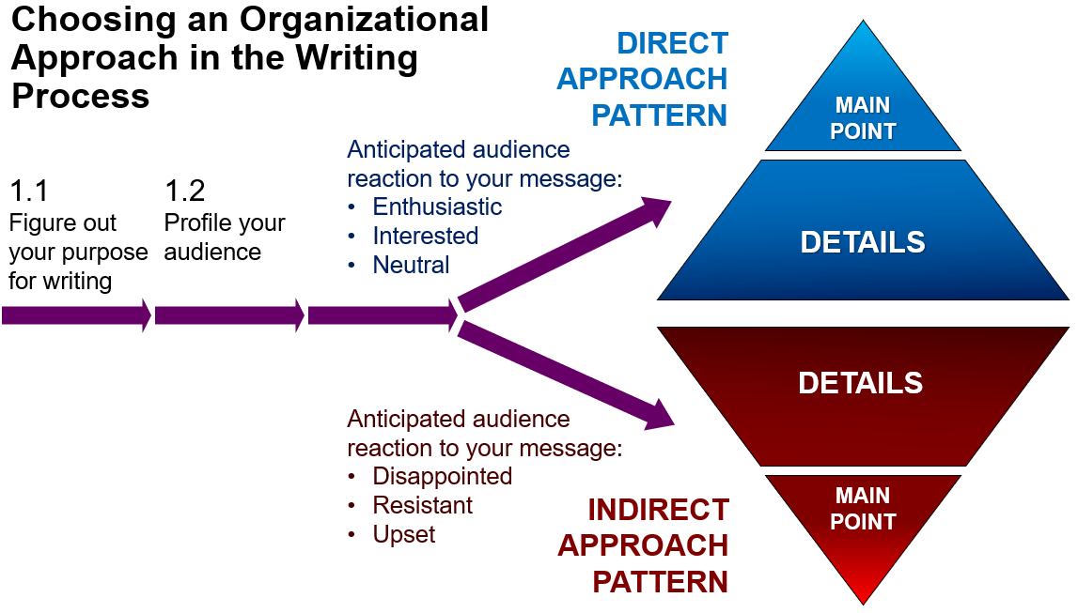

Slide 34
Persuasive Request Messages
Persuasive requests are messages that ask the reader to do something that s/he is inclined NOT to do:
request for favors and help
request for donations
request for cooperation (on projects and goals)
requests that require special privilege (such as for credit or adjustments not covered by the warranty)
requests that require the company to make an exception for you or change in policy or performance
sales letters

Slide 35

Since the reader automatically wants to refuse our request, we need to convince him/her of the benefits of doing what we’re asking. Therefore, the direct approach will not be effective. Instead, use the AIDA formula.

Slide 36
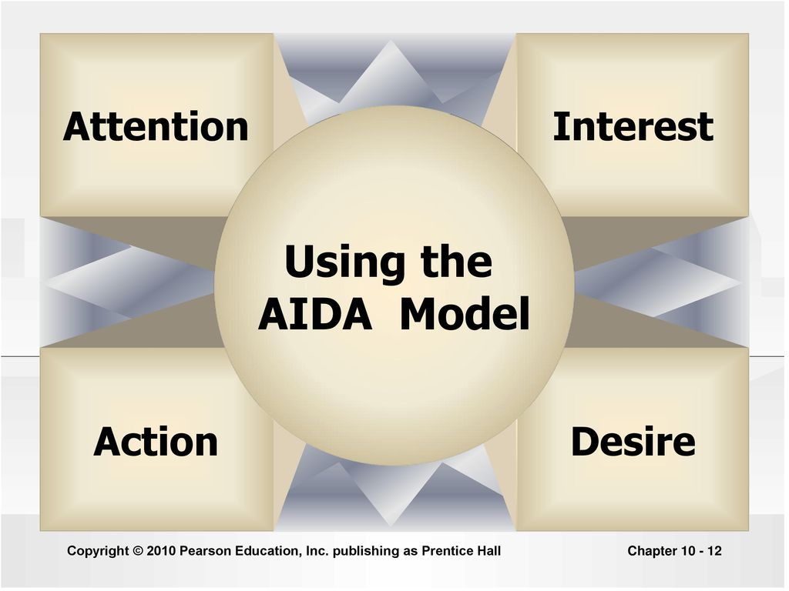
What is AIDA?

